Slide 1
Solving General Steiner Tree Problem Using Quantum Annealing
Author: Nguyen Duc Kien
VNU University of Engineering and Technology

Slide 2
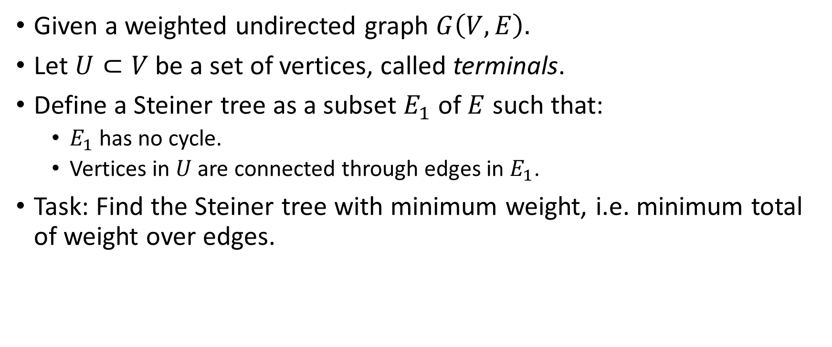
Problem Description
Given a weighted undirected graph $G\left(V, E\right).$
Let $U⊂V$ be a set of vertices, called terminals.
Define a Steiner tree as a subset $E_{1}$ of $E$ such that:
$E_{1}$ has no cycle.
Vertices in $U$ are connected through edges in $E_{1}$.
Task: Find the Steiner tree with minimum weight, i.e. minimum total of weight over edges.

Slide 3
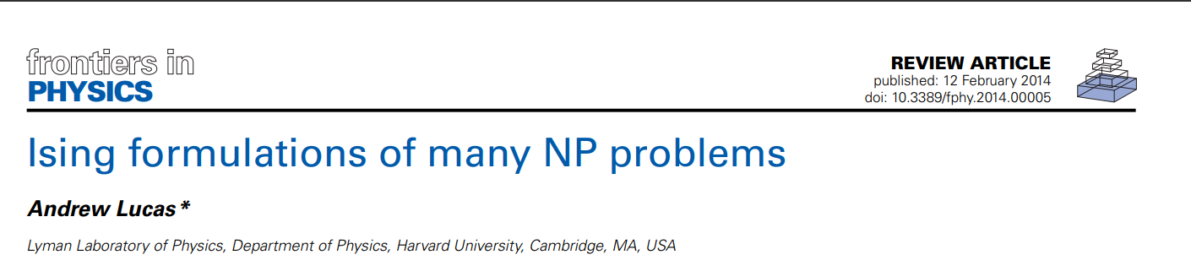
Lucas’ Solution
Many solutions exists
Uses Lucas’ solution, cited in Lucas A (2014) Ising formulations of many NP problems. Front. Physics 2:5. doi: 10.3389/fphy.2014.00005

Slide 4
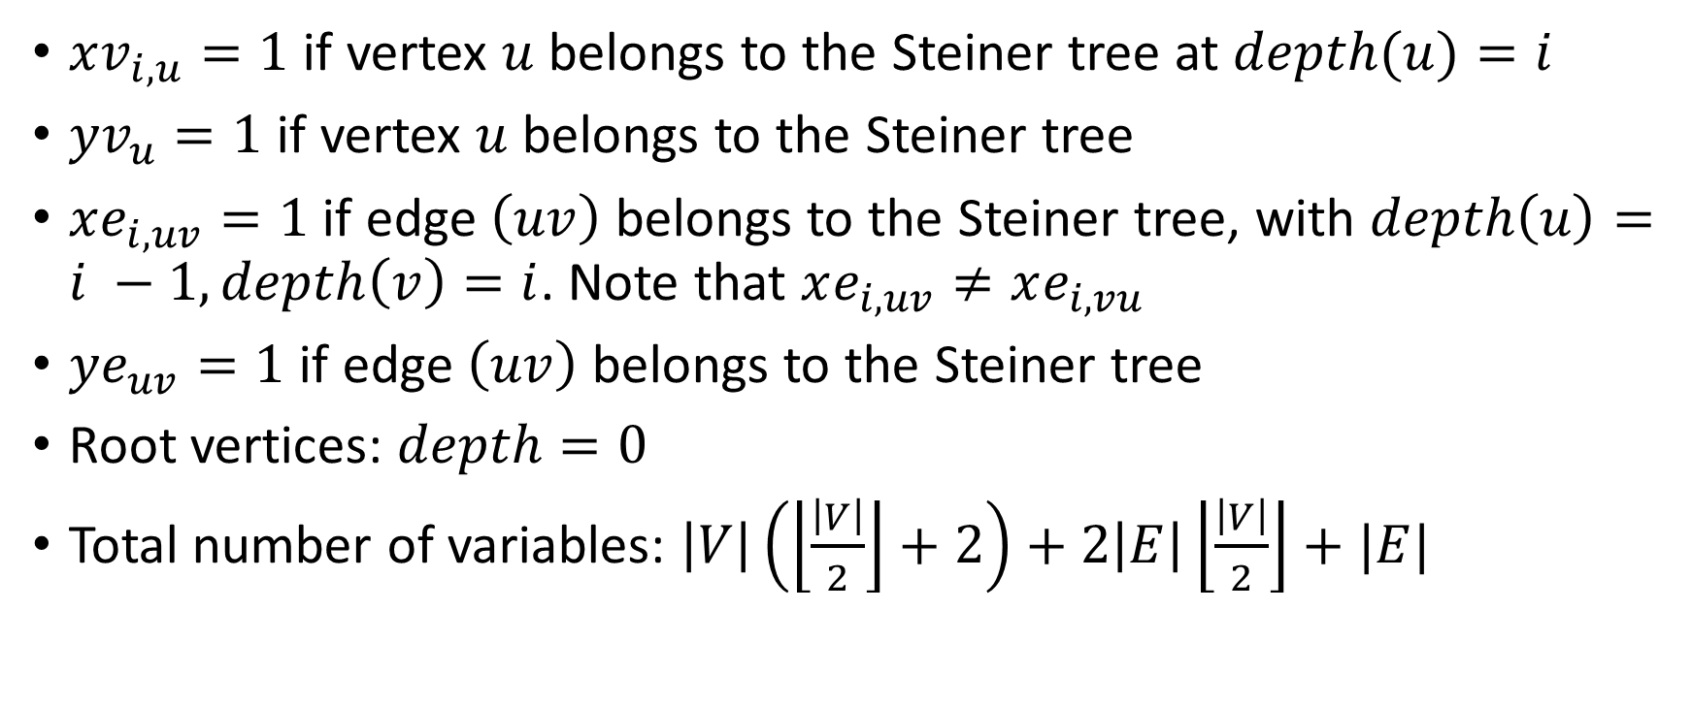
Variables
$xv_{i, u}=1$ if vertex $u$ belongs to the Steiner tree at $depth(u)=i$
$yv_{u}=1$ if vertex $u$ belongs to the Steiner tree
$xe_{i,uv}=1$ if edge $\left(uv\right)$ belongs to the Steiner tree, with $depth\left(u\right)=i −1, depth\left(v\right)=i$. Note that $xe_{i,uv}≠xe_{i,vu}$
$ye_{uv}=1$ if edge $\left(uv\right)$ belongs to the Steiner tree
Root vertices: $depth=0$
Total number of variables: $\left|V\right|\left(\left\lfloor \frac{\left|V\right|}{2}\right\rfloor +2\right)+2\left|E\right|\left\lfloor \frac{\left|V\right|}{2}\right\rfloor +|E|$

Slide 5

Hamiltonian Function (Energy Function)
$$H=H_{obj}+λH_{constraits}$$
$$H_{obj}=\sum_{\left(uv\right)∈E}{\sum_{i=1}^{mxD}{w_{uv}xe_{i,uv}}}$$
$$mxD=\left\lfloor \frac{|V|}{2}\right\rfloor +1$$
$$H_{constraits}=H_{1}+H_{2}+H_{3}+H_{4}+H_{5}+H_{6}$$

Slide 6

Hamiltonian Function (Energy Function)
Only one vertex can be the root
$$H_{1}={\left(1−\sum_{v∈V}{{xv}_{0,v}}\right)}^{2}$$
Terminals must be included in the Steiner tree
$$H_{2}=\sum_{v∈U}{{\left(1−\sum_{i=1}^{mxD}{{xv}_{i,v}}\right)}^{2}}$$
Non-terminals can appear at most ${ye}_{v}$ times
$$H_{3}=\sum_{v∈V\backslash U}{{\left(yv_{v}−\sum_{i=1}^{mxD}{{xv}_{i,v}}\right)}^{2}}$$

Slide 7

Hamiltonian Function (Energy Function)
Each vertex on the tree can have ≤1 edge connected from the ancestor
$$H_{4}=\sum_{x∈V}{\sum_{i=1}^{mxD}{{\left(xv_{i,v}−\sum_{\left(uv\right)∈E}{{xe}_{i,uv}}\right)}^{2}}}$$
If $xe_{i,uv}=1$, then $xv_{i−1,u}=1$ and $xv_{i,v}=1$
$$H_{5}=\sum_{(uv)∈E}{\sum_{i=1}^{mD}{(2−{xv}_{i−1,u}−{xv}_{i,v})}}$$
Edge $(uv)$ can appear at most $ye_{uv}$ times
$$H_{6}=\sum_{\left(uv\right)∈E}{{\left({ye}_{uv}−\sum_{i=1}^{mD}{\left({xe}_{i,uv}+xe_{i,vu}\right)}\right)}^{2}}$$

Slide 8
Convert to QUBO matrix
def get(var = "xv", depth = 0, param1 = 0, param2 = 0):
if (var == "xv"):
if (depth == 0): return param1
return n + (depth - 1) * (n + m) + param1
if (var == "xe"):
if (inEdgeList(param1, param2) == False):
return -1
return n + (depth - 1) * (n + m) + n + edgeList.index((param1, param2))

Slide 9
Convert to QUBO matrix
if (var == "yv"):
return n + (maxDepth - 1) * (n + m) + param1
if (var == "ye"):
if (inEdgeList(param1, param2) == False):
return -1
return n + (maxDepth - 1) * (n + m) + n + edgeList.index((param1, param2))

Slide 10
Solve with Quantum Annealing
chainStrength = uniform_torque_compensation(
bqm=BinaryQuadraticModel.from_qubo(q)
prefactor=__prefactor)
sampler = EmbeddingComposite(DWaveSampler())
response = sampler.sample_qubo(
q,
chain_strength=chainStrength,
num_reads=numReads,
label='Steiner Tree Soltuion',
annealing_time=__annealing_time
)

Slide 11
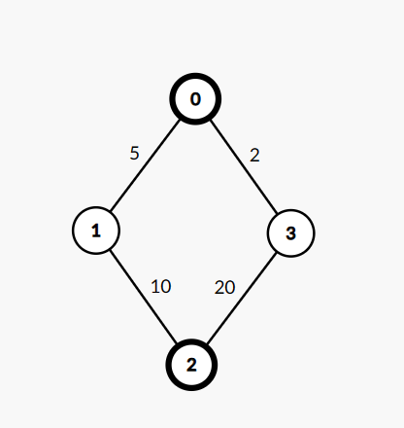

Result (1)
On graph $C_{4}$ with $U=(0,2)$:
Optimal answer is 15

Slide 12
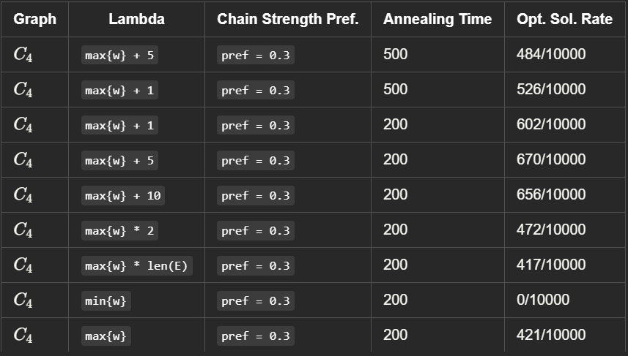

Result (1)
Successful (optimal answer found) rate with varying value of $λ$:

Slide 13
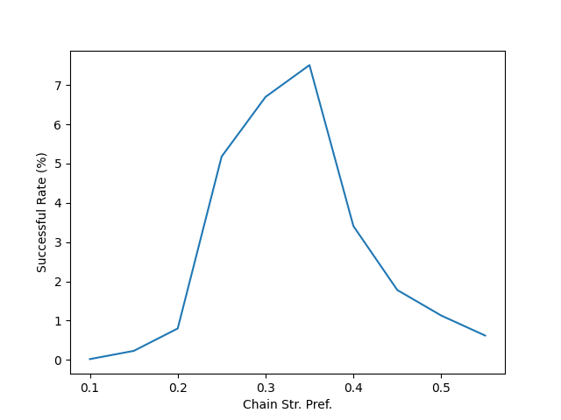
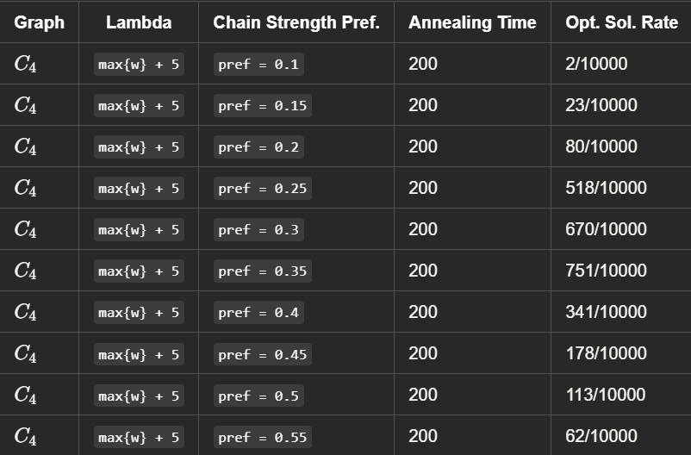
Result (1)
Successful rate with varying chain strength

Slide 14
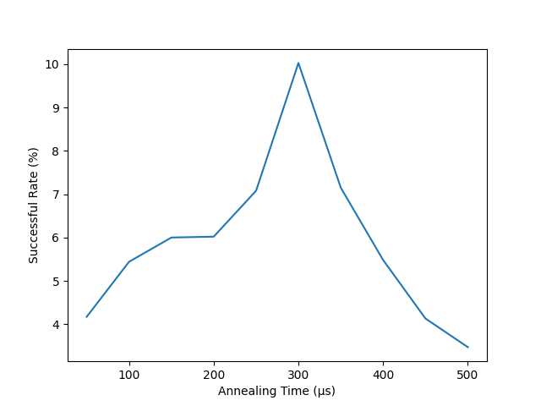
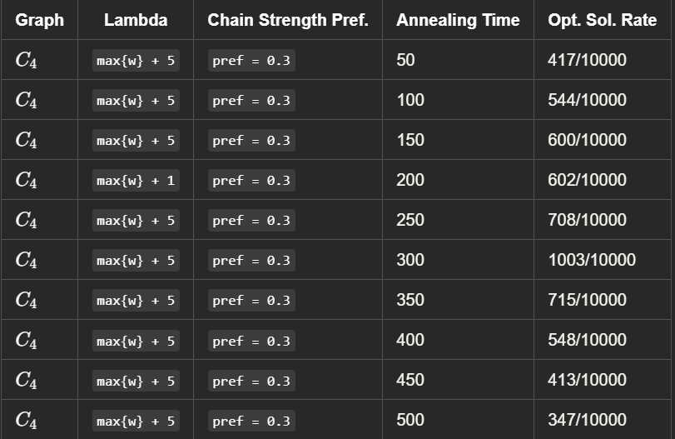
Result (1)
Successful rate with varying annealing time

Slide 15
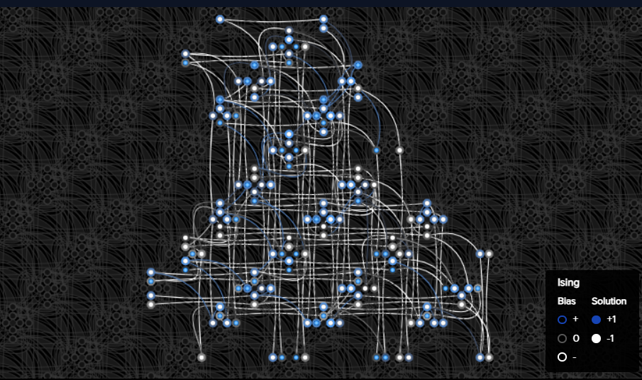
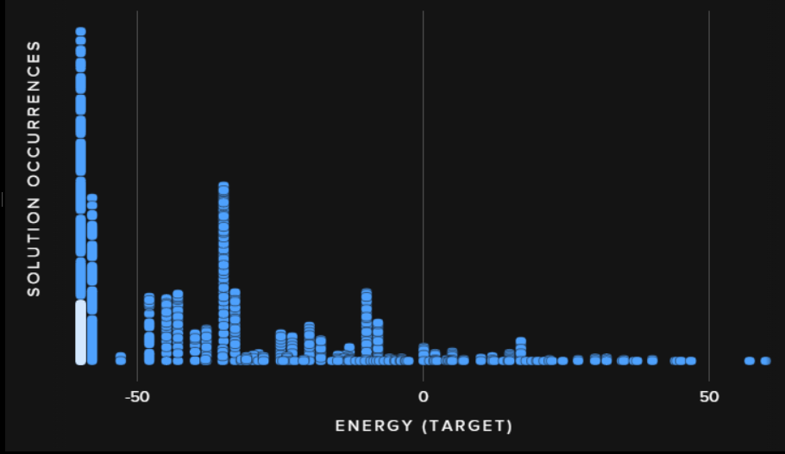
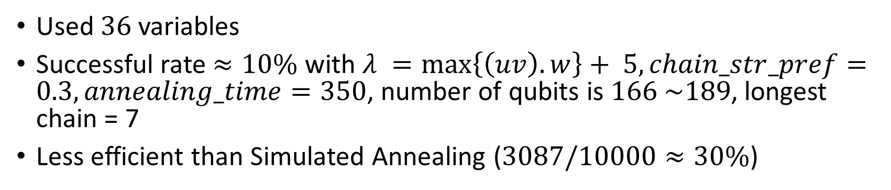
Result (1)
Used $36$ variables
Successful rate $≈10\%$ with $λ =\max\left\{\left(uv\right).w\right\}+ 5,chain_str_pref=0.3, annealing_time=350$, number of qubits is $166 \sim 189$, longest chain = 7
Less efficient than Simulated Annealing ($3087/10000≈30\%$)

Slide 16
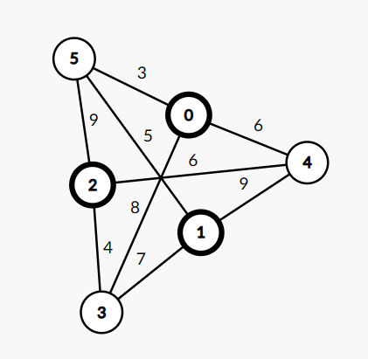

Result (2)
Graph $K_{3,3}$ with $U=\left\{0, 1, 2\right\}$
Optimal solution is $17$ $(\left(0, 5\right), \left(1, 5\right), \left(2, 5\right))$

Slide 17
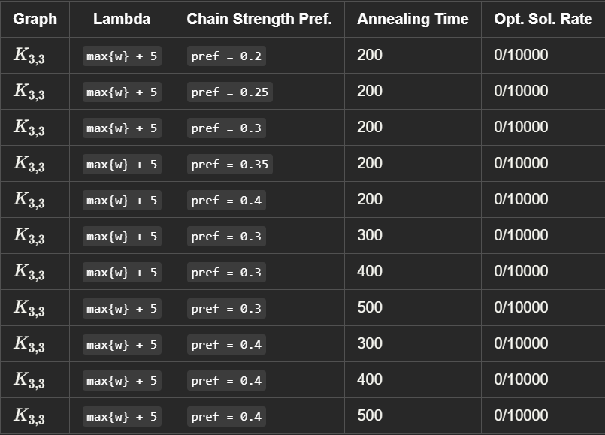
Result (2)
Result is pessimistic …

Slide 18
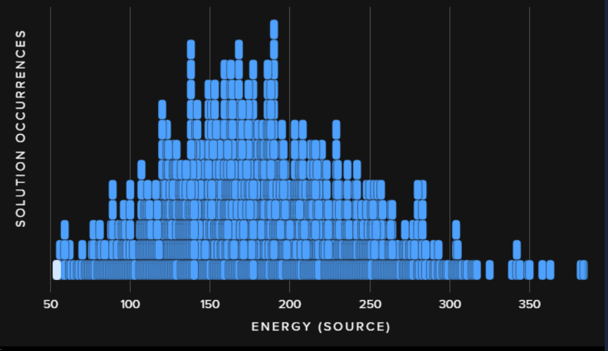

Result (2)
Used 93 variables, $\sim 1045$ qubits, longest chain = 18
No configuration tested provides an optimal solution
Less efficient than Simulated Annealing ($680/10000≈7\%)$

Slide 19
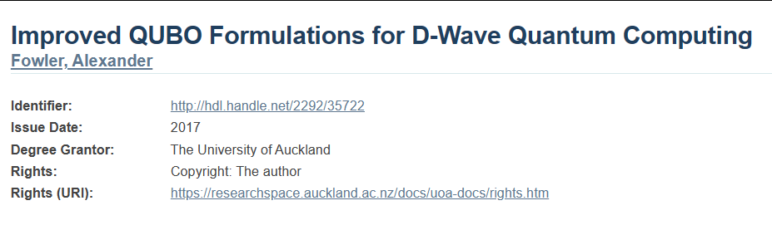
Fowler’s Solution
Mentioned in Improved QUBO formulations for D-Wave quantum computing. Ph.D. Thesis, University of Auckland (2017)

Slide 20
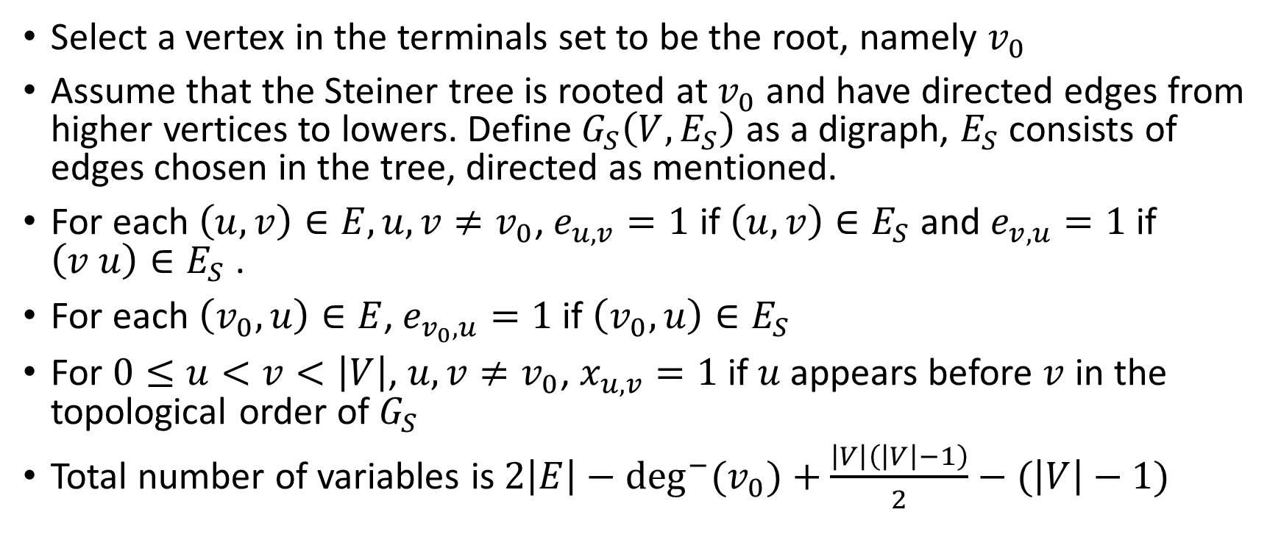
Variables (BQM)
Select a vertex in the terminals set to be the root, namely $v_{0}$
Assume that the Steiner tree is rooted at $v_{0}$ and have directed edges from higher vertices to lowers. Define$G_{S}\left(V, E_{S}\right)$ as a digraph, $E_{S}$ consists of edges chosen in the tree, directed as mentioned.
For each $\left(u, v\right)∈E, u, v≠v_{0}$, $e_{u, v}=1$ if $\left(u, v\right)∈E_{S}$ and $e_{v, u}=1$ if $\left(v u\right)∈E_{S}$ .
For each $\left(v_{0},u\right)∈E$, $e_{v_{0},u}=1$ if $\left(v_{0},u\right)∈E_{S}$
For $0≤u<v<\left|V\right|$, $u, v≠v_{0}$, $x_{u,v}=1$ if $u$ appears before $v$ in the topological order of $G_{S}$
Total number of variables is $2\left|E\right|−\deg^{−}{{(v}_{0})}+\frac{\left|V\right|\left(\left|V\right|−1\right)}{2}−(\left|V\right|−1)$

Slide 21
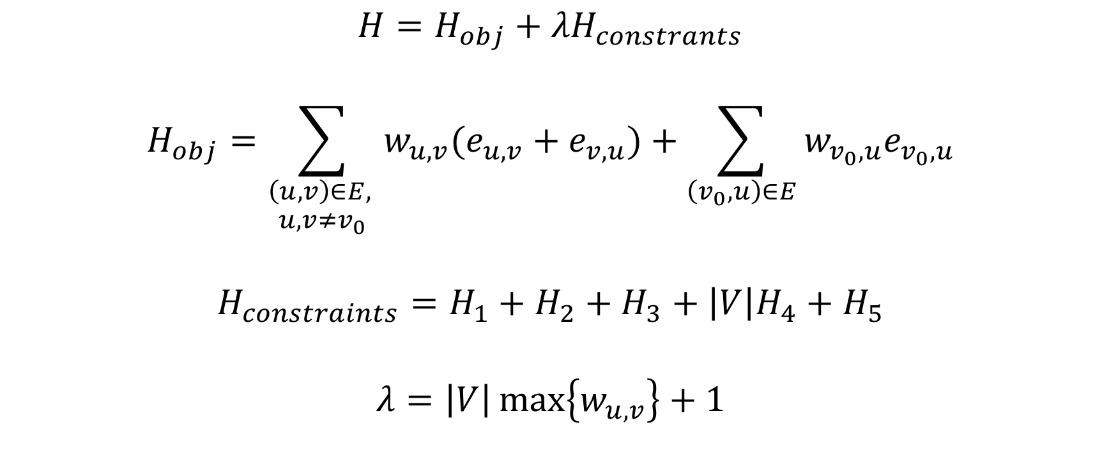
Hamiltonian
$$H=H_{obj}+{λH}_{constrants}$$
$$H_{obj}=\sum_{\begin{aligned}\left(u,v\right)∈E, \\ u, v≠v_{0}\end{aligned}}{w_{u,v}(e_{u,v}+e_{v,u})}+\sum_{\left(v_{0},u\right)∈E}{w_{v_{0},u}e_{v_{0},u}}$$
$$H_{constraints}=H_{1}+H_{2}+H_{3}+\left|V\right|H_{4}+H_{5}$$
$$λ=\left|V\right|\max\left\{w_{u,v}\right\}+1$$

Slide 22

Hamiltonian
$$H_{1}=\sum_{\begin{aligned}0≤u<v<w<\left|V\right|, \\ u,v,w≠v_{0}\end{aligned}}{(x_{u,w}+x_{u,v}x_{v,w}−x_{u,v}x_{u,w}}−x_{u,w}x_{v,w})$$
$$H_{2}=\sum_{\begin{aligned}\left(u,v\right)∈E, \\ u<v, \\ u,v≠v_{0}\end{aligned}}{e_{u,v}\left(1−x_{u,v}\right)+e_{v,u}x_{u,v}}$$

Slide 23
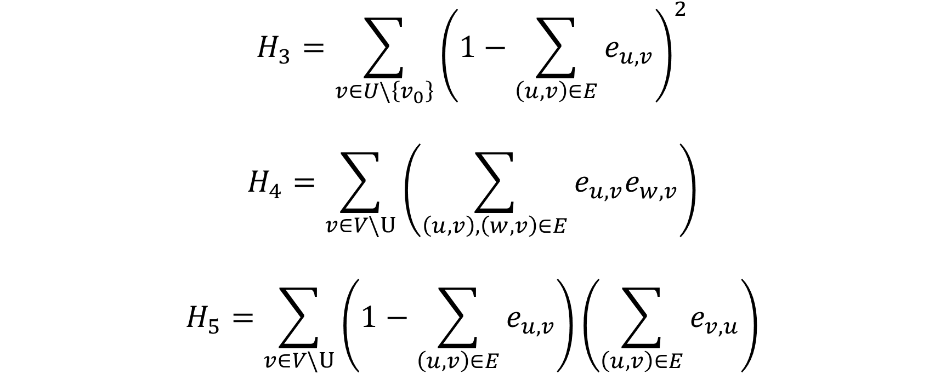
Hamiltonian
$$H_{3}=\sum_{v∈U\backslash \left\{v_{0}\right\}}{{\left(1−\sum_{\left(u,v\right)∈E}{e_{u,v}}\right)}^{2}}$$
$$H_{4}=\sum_{v∈V\backslash U}{\left(\sum_{\left(u,v\right),\left(w,v\right)∈E}{e_{u,v}e_{w,v}}\right)}$$
$$H_{5}=\sum_{v∈V\backslash U}{\left(1−\sum_{\left(u,v\right)∈E}{e_{u,v}}\right)\left(\sum_{\left(u,v\right)∈E}{e_{v,u}}\right)}$$

Slide 24

Result (1)
$C_{4}$ with $U=\{0,2\}$ as above, optimal answer is $15$

Slide 25
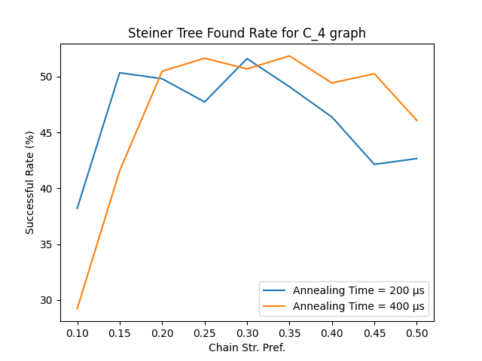
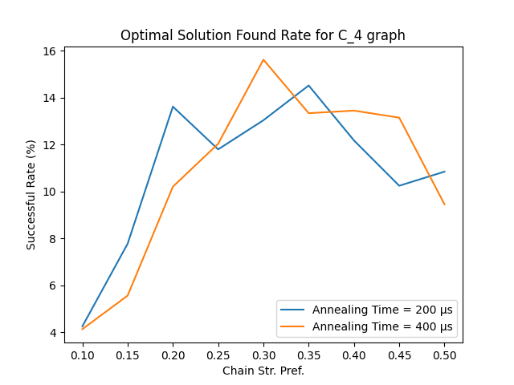
Result (1)

Slide 26
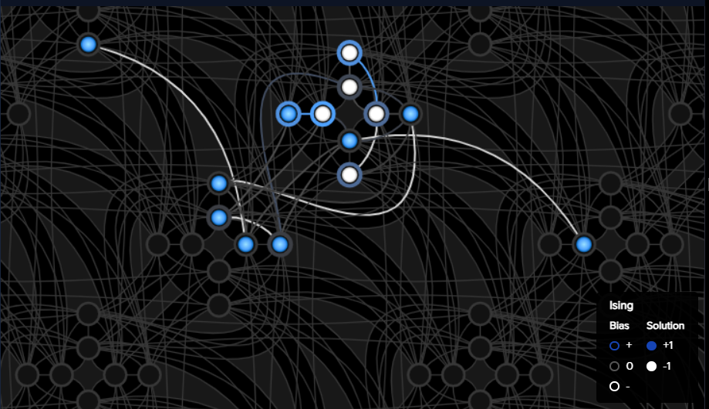

Result (1)
$9$ variables embedded to $≈15$ qubits

Slide 27
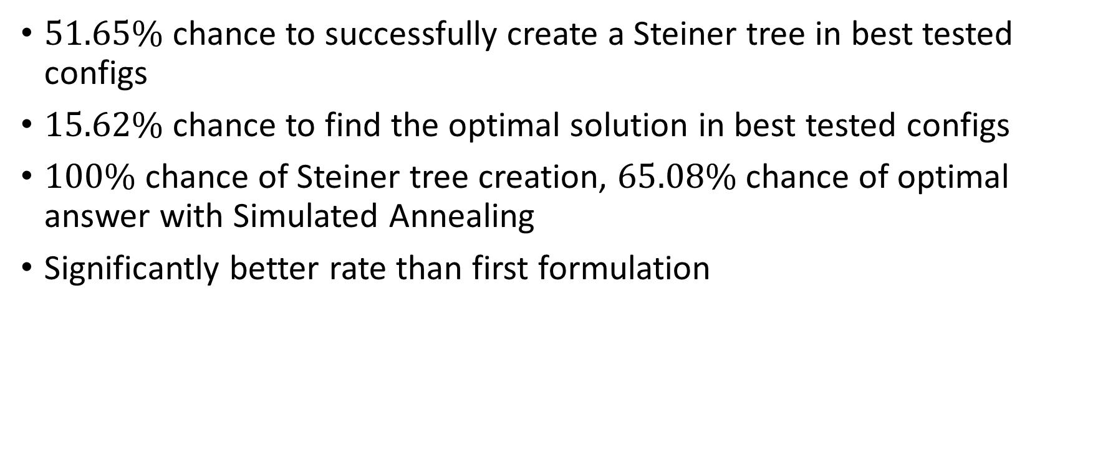
Result (1)
$51.65\%$ chance to successfully create a Steiner tree in best tested configs
$15.62\%$ chance to find the optimal solution in best tested configs
$100\%$ chance of Steiner tree creation, $65.08\%$ chance of optimal answer with Simulated Annealing
Significantly better rate than first formulation

Slide 28

Result (2)
$K_{3,3}$ with $U=\{0,1,2\}$ as above, optimal answer is $17$

Slide 29
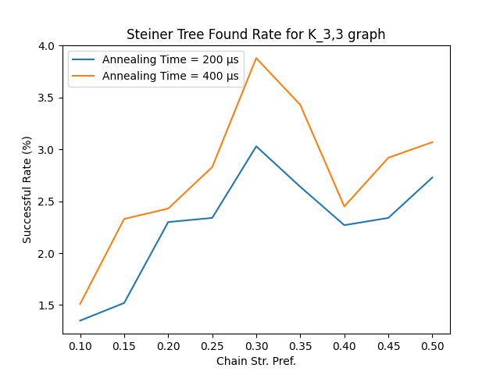
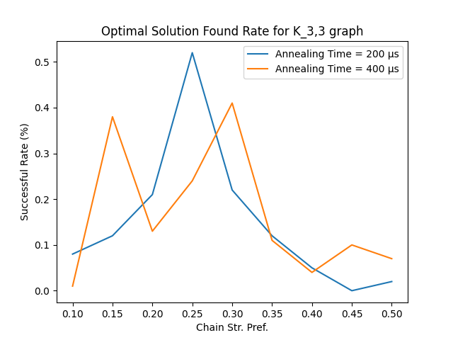
Result (2)

Slide 30
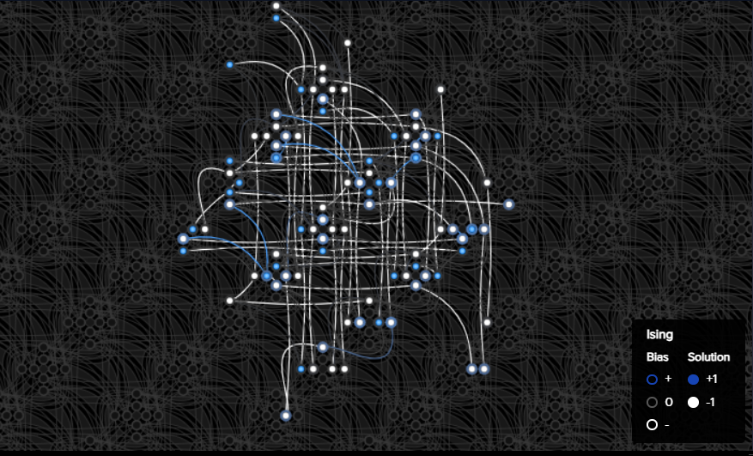

Result (2)
$26$ variables embedded into $≈90$ qubits

Slide 31
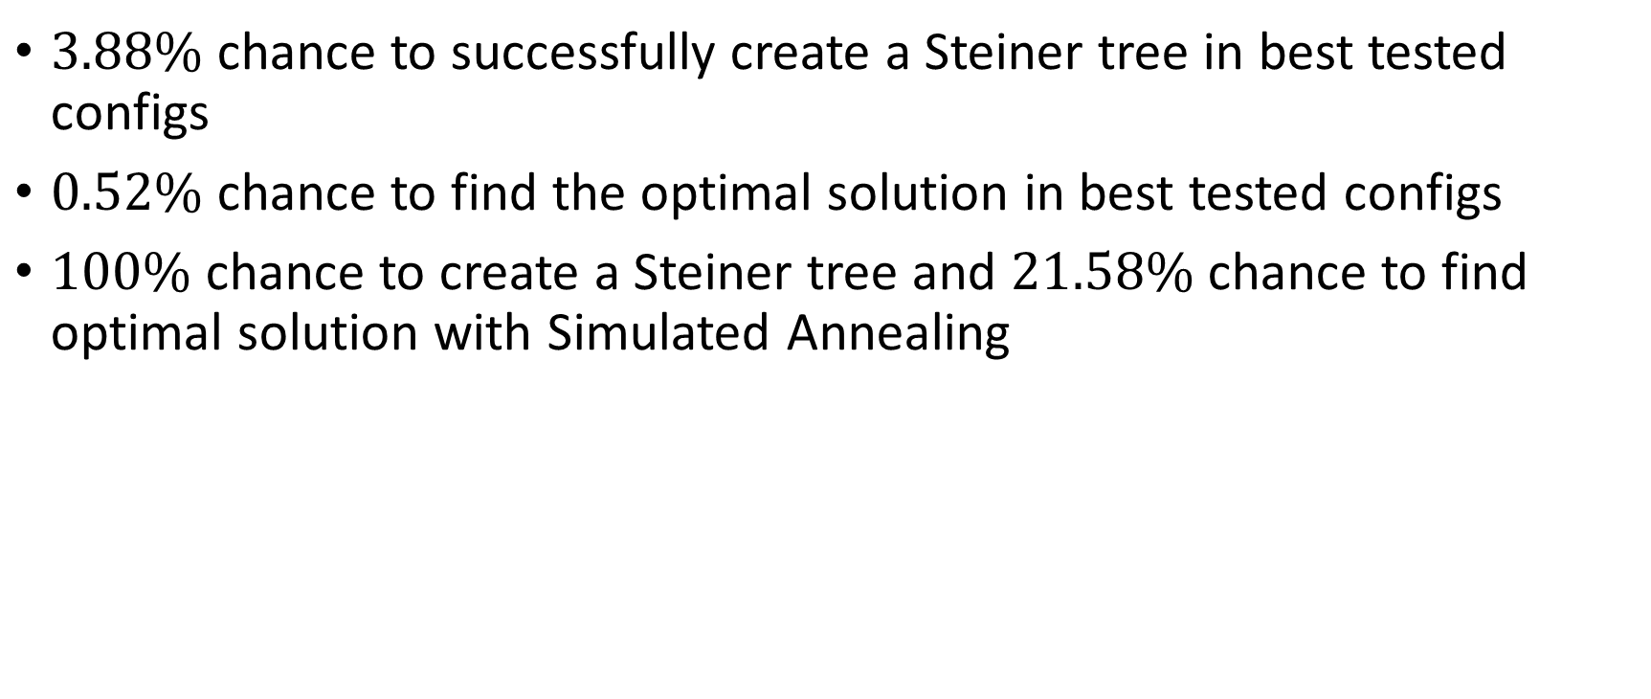
Result (2)
$3.88\%$ chance to successfully create a Steiner tree in best tested configs
$0.52\%$ chance to find the optimal solution in best tested configs
$100\%$ chance to create a Steiner tree and $21.58\%$ chance to find optimal solution with Simulated Annealing

Slide 32
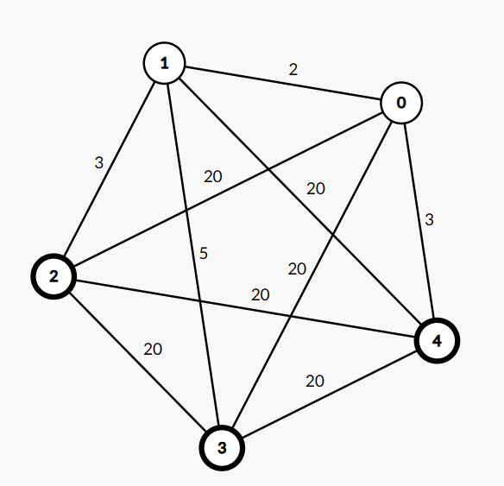

Result (3)
Complete graph $K_{5}$, $U=\left\{2, 3, 4\right\}$
Some edges have smaller weights
Optimal solution is $13$

Slide 33
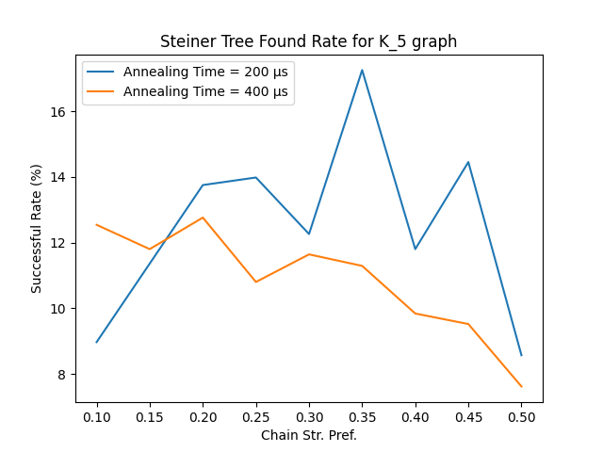
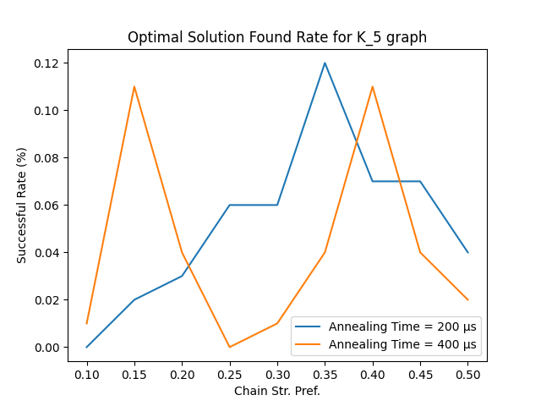
Result (3)

Slide 34
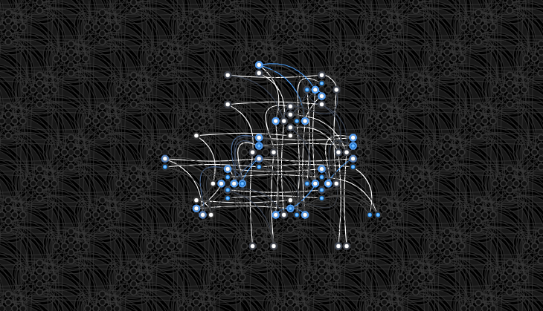

Result (3)
$22$ variables embedded into $≈65$ qubits

Slide 35
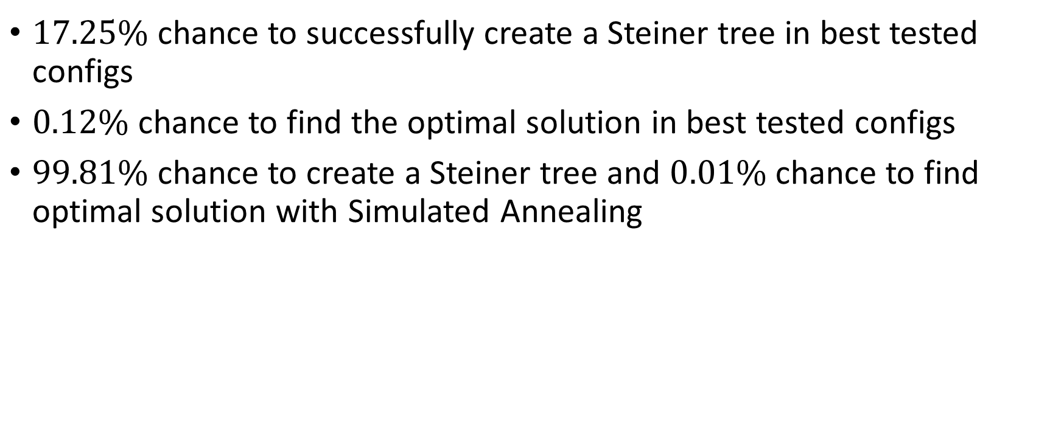
Result (3)
$17.25\%$ chance to successfully create a Steiner tree in best tested configs
$0.12\%$ chance to find the optimal solution in best tested configs
$99.81\%$ chance to create a Steiner tree and $0.01\%$ chance to find optimal solution with Simulated Annealing

Slide 36
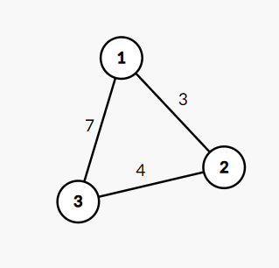
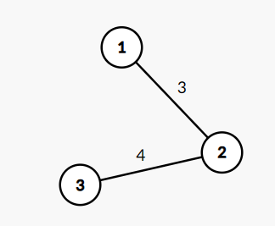
Optimization
Can apply some optimizations to reduce the number of edges
Direct edges having the length equal to the sum of two others can be ignored
Also combine nodes with the same value (weight = 0)

Slide 37
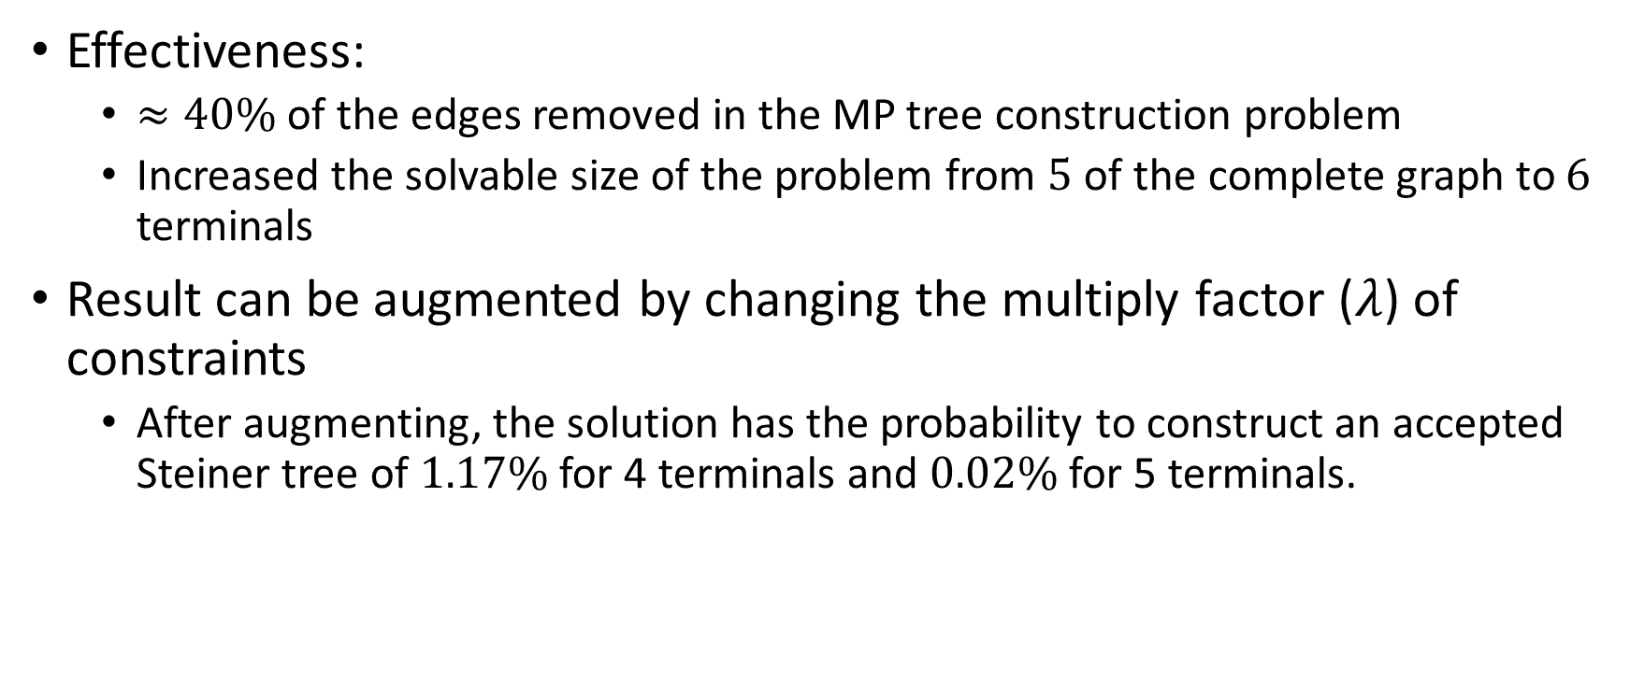
Optimization
Effectiveness:
$≈40\%$ of the edges removed in the MP tree construction problem
Increased the solvable size of the problem from $5$ of the complete graph to $6$ terminals
Result can be augmented by changing the multiply factor ($λ$) of constraints
After augmenting, the solution has the probability to construct an accepted Steiner tree of $1.17\%$ for 4 terminals and $0.02\%$ for 5 terminals.

Slide 38
Optimization
Pick the center node among the terminals (i.e. the node having the smallest maximum total distance to others) as the DAG root.
Does not reduce the number of edge in most cases.
Unsure if increased success chance

Slide 39
Optimization
Other optimizations:
Add a constraint that terminals should not have any edge leaving them
Only available if terminals are not combined
Will refine Steiner tree creation rate

Slide 40
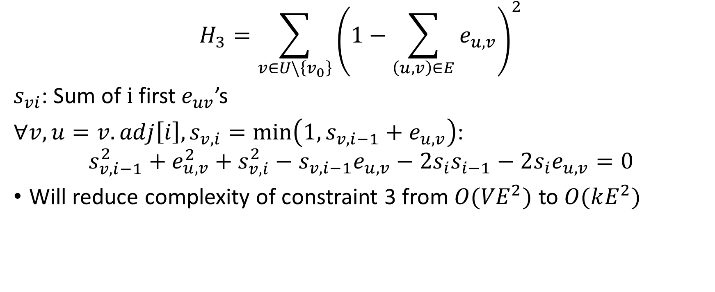
Change of variables
$$H_{3}=\sum_{v∈U\backslash \left\{v_{0}\right\}}{{\left(1−\sum_{\left(u,v\right)∈E}{e_{u,v}}\right)}^{2}}$$
$s_{vi}$: Sum of$i$first$e_{uv}$’s
$∀v,u=v.adj\left[i\right], s_{v,i}=\min\left(1,s_{v,i−1}+e_{u, v}\right)$:
$$s_{v,i−1}^{2}+e_{u,v}^{2}+s_{v,i}^{2}−s_{v,i−1}e_{u,v}−2s_{i}s_{i−1}−2s_{i}e_{u,v}=0$$
Will reduce complexity of constraint 3 from ${O(VE}^{2})$ to $O(kE^{2})$

Slide 41




Slide 42
Hybrid test

